Slide 1
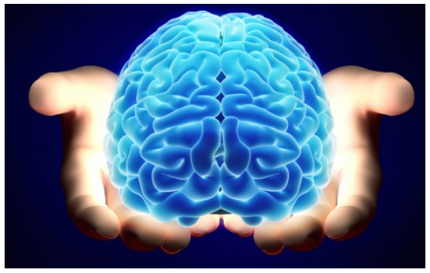
Radioactive mind

Slide 2

Scene 1
This scene will start during the day from when the main character wakes up, through out his day we are abler to hear voices talking to him, this is his schizophrenia, he leaves and goes shopping and finishes his day, he takes him medication at night although he doesn’t want to take it.

Slide 3

Scene 2
This is when the main character tries to sleep, however halfway through the night he suffers from a major seizure and smashes his head on the bed frame, his mother finds him and rushes him to hospital.

Slide 4

Scene 3
In this scene he has been announced to his family that he is in a coma, several weeks after he entered the coma, his family started to suffer from injuries due to falling down stairs and accidentally hurting themselves, also the number of terrorist attacks have increased.

Slide 5
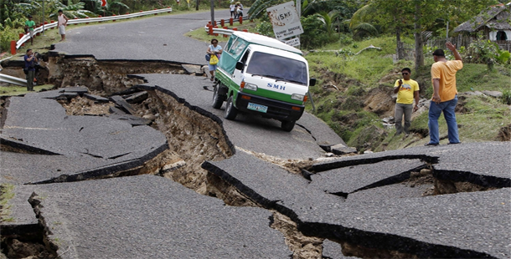
Scene 4
The main characters family started hearing voices as well, such as “help me, for your sake”, they were all confused and scared but didn’t know who was talking to them, whilst the character was in the hospital a major earthquake hit the hospital, killed many people except from him, his parents tried rescuing him but died in the process.

Slide 6
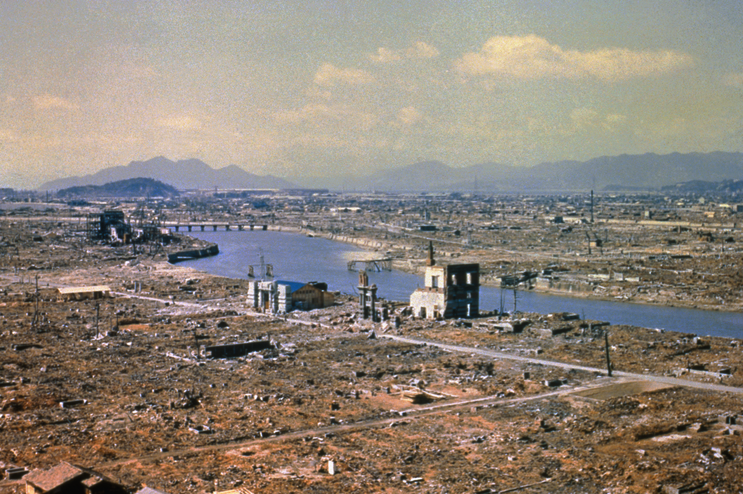
Scene 5
Now the main character was able to set off nuclear bombs with his mind, he is able to bomb the entire world until nothing but rubble and a half collapsed hospital, final shot is a shot of the main character above waking up to the damage he's caused.

Slide 7

Inspirations
Certain films did inspire me to make this short film, such as the Marvel Xmen franchise, one character called Charles Xavier is a mutant who is able to use his mind to control, manipulate and find other people within the world, if in the wrong hand his powers could cause mass destruction, as in our cause the main characters power is out of control and cant control what happens. Another film franchise I got inspiration from was the star wars saga, in the film star wars there is a power called the force which allows someone to control surroundings and also peoples mind.

Slide 8

My research
I have researched certain mental illnesses due to the characters power being activated by a seizure, the character suffers from both schizophrenia and epilepsy, through out the film voices can be heard in his head, I state the illness due to him refusing to take his medication, the cause of his power was created from a seizure he suffered.

Slide 9
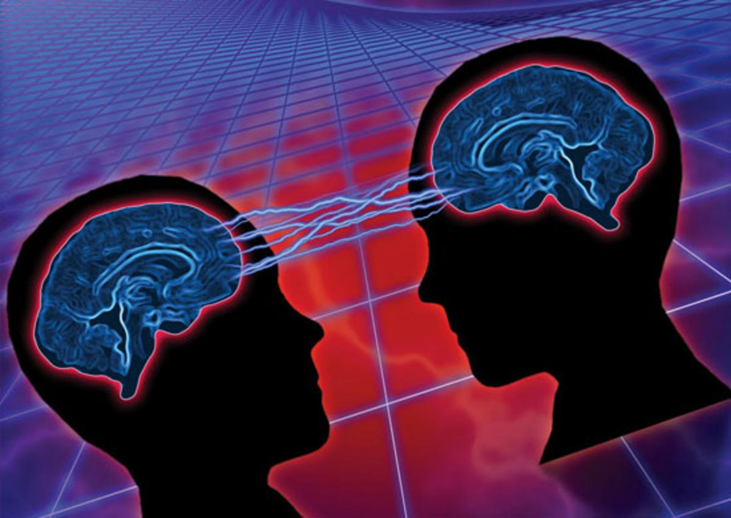
Initial ideas
My initial Idea was defiantly going to involve a character who is capable of destroying the world, however I also wanted the character to be completely oblivious to him controlling it.

Slide 10

Reality
This film could be easy to create, for the first half I need to film one character living a normal everyday life, he's going to wake up, go shopping and complete various daily activities, however he can here voices throughout the day, when he sleeps that night he ends up having an epileptic seizure, causing him to enter a coma, this may be hard to film, however I may be able to get equipment due to family members working in a hospital, after this I need to try and cause mass destruction to every thing around him, this part would be the hardest due to a low budget.

Slide 11

Most feasible
The most feasible idea would to have the same aspect but without the hospital scene and mass destruction, maybe it could cause grief to just his family.

Slide 12

Genre
This short film is going to be an action/ thriller film, this is due to the destruction and high movement film.

Slide 13

Target audience
The target audience would be between the ages of around 12-30 as it is clearly understandable but quite violent.

